Slide 1
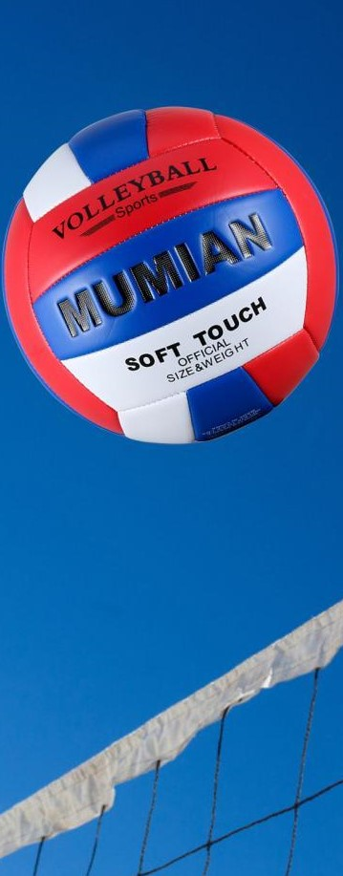
Westside High School
Dec. 5-9 Week At a Glance (WAG)

Slide 2
Coach Thomas
Rec. Games: Dec 5-9

Slide 3
Dec. 5
Standard:
PERG.1 The physically educated student demonstrates competency in a variety of motor skills and movement patterns.
a. Demonstrates competence while performing skills in a variety of recreational game settings and activities
b. Performs skills at a level of competence, which contributes to health-related fitness.
c. Demonstrates proper warm-up and cool-down protocol associated with different life time
sport physical activities.
PERG. 2 The physically educated student applies the knowledge of concepts, principles, strategies, and tactics related to movement and performance.
Integrates a variety of strategies, tactics, concepts, and skills during recreational games activities
Evaluates skills needed for recreational games and leisure activities
PERG.3 The physically educated student demonstrates knowledge and skills to help achieve
and maintain a health-enhancing level of physical activity and fitness.
a. Maintains or improves fitness level by using the results of the Georgia Fitness Assessment
to guide changes in a personal program of physical activity.
b. Uses technologies to assess, enhance, and maintain health-related and skill-related fitness.
c. Analyzes the relationship between physical activity and longevity.
Personal and Social Behavior, Rules, Safety, and Etiquette
Monday - Agenda
Learning Target
I can login to Infinite Campus and access my classes and grades
I can use this to determine the assignments I need to complete to bring my grade up
Opening ( 10-15 mins)
5-10 minute Walk & Attendance
Work-session ( 20 - 25 mins)
Locker rooms (5 minutes)
Coach will review learning targets
Student access Infinite Campus to see missing assignments and complete them according to coach’s expectations (those that do not have technology can get assignments from teacher)
When students have completed make-ups for today, teacher will provide basketball and volleyball for free play
Criteria for Success
Students can access Infinite Campus to see the assignments they are missing along with current grade
Students will perform the necessary task to complete missing assignments that we have done so far this semester
Closing ( 05 – 10 mins)
-locker room unlocked for 5 minutes
-students use remaining time to cool down & rehydrate if necessary

Slide 4
Dec. 6 Standard:
PERG.1 The physically educated student demonstrates competency in a variety of motor skills and movement patterns.
a. Demonstrates competence while performing skills in a variety of recreational game settings and activities
b. Performs skills at a level of competence, which contributes to health-related fitness.
c. Demonstrates proper warm-up and cool-down protocol associated with different life time
sport physical activities.
PERG. 2 The physically educated student applies the knowledge of concepts, principles, strategies, and tactics related to movement and performance.
Integrates a variety of strategies, tactics, concepts, and skills during recreational games activities
Evaluates skills needed for recreational games and leisure activities
PERG.3 The physically educated student demonstrates knowledge and skills to help achieve
and maintain a health-enhancing level of physical activity and fitness.
a. Maintains or improves fitness level by using the results of the Georgia Fitness Assessment
to guide changes in a personal program of physical activity.
b. Uses technologies to assess, enhance, and maintain health-related and skill-related fitness.
c. Analyzes the relationship between physical activity and longevity.
Personal and Social Behavior, Rules, Safety, and Etiquette
Tuesday - Agenda
Learning Target
Same as previous day
Opening ( 10-15 mins)
10 minute Walk & Attendance
Work-session ( 20 - 25 mins)
Same as previous day for “B” block periods
Criteria for Success
Same as previous day
Closing ( 05 – 10 mins)
locker room unlocked for 5 minutes
-students use remaining time to cool down & rehydrate if necessary

Slide 5
Dec.7 Standard:
PERG.1 The physically educated student demonstrates competency in a variety of motor skills and movement patterns.
a. Demonstrates competence while performing skills in a variety of recreational game settings and activities
b. Performs skills at a level of competence, which contributes to health-related fitness.
c. Demonstrates proper warm-up and cool-down protocol associated with different life time
sport physical activities.
PERG. 2 The physically educated student applies the knowledge of concepts, principles, strategies, and tactics related to movement and performance.
Integrates a variety of strategies, tactics, concepts, and skills during recreational games activities
Evaluates skills needed for recreational games and leisure activities
PERG.3 The physically educated student demonstrates knowledge and skills to help achieve
and maintain a health-enhancing level of physical activity and fitness.
a. Maintains or improves fitness level by using the results of the Georgia Fitness Assessment
to guide changes in a personal program of physical activity.
b. Uses technologies to assess, enhance, and maintain health-related and skill-related fitness.
c. Analyzes the relationship between physical activity and longevity.
Personal and Social Behavior, Rules, Safety, and Etiquette
Wednesday - Agenda
Learning Target
Same as previous day –A block period
Opening ( 10-15 mins)
10 minute Walk & Attendance
Work-session ( 20 - 25 mins)
Those students that were not present on Monday will be provided the same opportunities and this will be day 2 opportunity for those that were present on Monday
Criteria for Success
Same as previous day.
Closing ( 05 – 10 mins)
-locker room unlocked for 5 minutes
-students use remaining time to cool down & rehydrate if necessary

Slide 6
Dec.8 Standard:
PERG.1 The physically educated student demonstrates competency in a variety of motor skills and movement patterns.
a. Demonstrates competence while performing skills in a variety of recreational game settings and activities
b. Performs skills at a level of competence, which contributes to health-related fitness.
c. Demonstrates proper warm-up and cool-down protocol associated with different life time
sport physical activities.
PERG. 2 The physically educated student applies the knowledge of concepts, principles, strategies, and tactics related to movement and performance.
Integrates a variety of strategies, tactics, concepts, and skills during recreational games activities
Evaluates skills needed for recreational games and leisure activities
PERG.3 The physically educated student demonstrates knowledge and skills to help achieve
and maintain a health-enhancing level of physical activity and fitness.
a. Maintains or improves fitness level by using the results of the Georgia Fitness Assessment
to guide changes in a personal program of physical activity.
b. Uses technologies to assess, enhance, and maintain health-related and skill-related fitness.
c. Analyzes the relationship between physical activity and longevity.
Personal and Social Behavior, Rules, Safety, and Etiquette
Thursday - Agenda
Learning Target
Same as previous day
Opening ( 10-15 mins)
5 minute Walk & Attendance
Work-session ( 20 - 25 mins)
Same as previous day for B block periods
Criteria for Success
Same as previous day
Closing ( 05 – 10 mins)
-locker room unlocked for 5 minutes
-students use remaining time to cool down & rehydrate if necessary

Slide 7
Friday - Agenda
Learning Target
Dec.9 Standard:
PERG.1 The physically educated student demonstrates competency in a variety of motor skills and movement patterns.
a. Demonstrates competence while performing skills in a variety of recreational game settings and activities
b. Performs skills at a level of competence, which contributes to health-related fitness.
c. Demonstrates proper warm-up and cool-down protocol associated with different life time
sport physical activities.
PERG.3 The physically educated student demonstrates knowledge and skills to help achieve
and maintain a health-enhancing level of physical activity and fitness.
a. Maintains or improves fitness level by using the results of the Georgia Fitness Assessment
to guide changes in a personal program of physical activity.
b. Uses technologies to assess, enhance, and maintain health-related and skill-related fitness.
c. Analyzes the relationship between physical activity and longevity.
Personal and Social Behavior, Rules, Safety, and Etiquette
Freestyle Friday
Opening ( 10-15 mins)
Attendance
Work-session ( 20 - 25 mins)
Students are able to engage in various activities/sports typically those that they are most interested
Teacher will conference will students and possibly make parent phone calls/contact as needed
Criteria for Success
I can demonstrate my understanding of the rules, procedures, and expectations by following them during class time and asking questions to teacher if necessary.
Closing ( 05 – 10 mins)
N/A

Slide 8
Resources

